Slide 1

CREATED BY TEAM: DRUG DRUG DRUG WHAT?
Notes:
GOOD DAY! I AM JENINA ESGUERRA. TOGETHER WITH IVY PUGOY, EZAIRA SANDOVAL, AND GABRIEL DON MADERAZO TO PRESENT AND DISCUSS OUR PROJECT ENTITLED JUSTICE OVER WAR ORN DRUGS

Slide 2

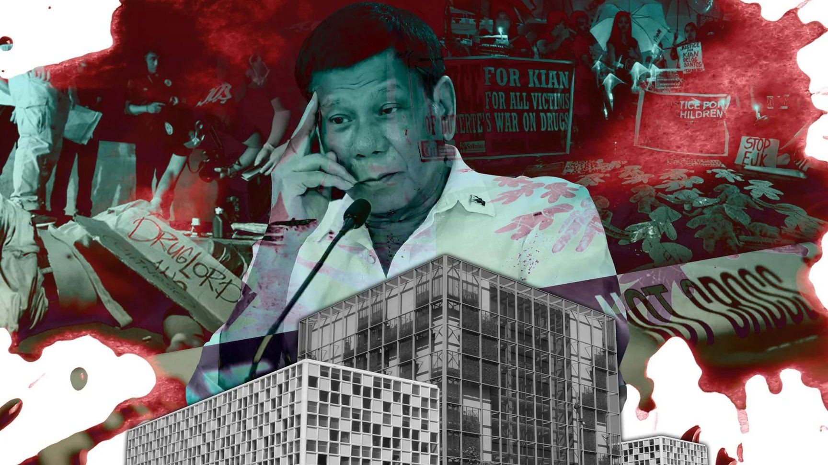
CONTENTS
INTRODUCTION
PROBLEM
SIGNIFICANCE
ANALYSIS
RECOMMENDATIONS

Slide 3

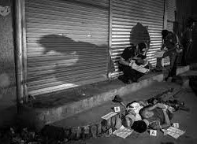
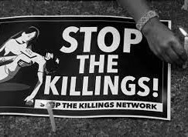
INTRODUCTION
The war on drugs launched by Former President Rodrigo Duterte in the Philippines in 2016 is a highly controversial issue that has been a topic of debate among human rights advocates and lawmakers on a global level. The President's motivation stemmed from his promises to crack down on drug-related issues, bringing profound changes to the country's approach to drug abuse ultimately. Duterte has claimed that his crackdown on drugs aims at resolving the drug menace in the country, and his supporters argue that these actions are necessary to make the streets safer.
Notes:
The government admits that over 6,000 killings have occurred during police operations in association with the drug war. Many officers, however, have already been absolved of any wrongdoing in those incidents during internal police investigations. While the DOJ’s plan to review these killings is a welcome step for many victims’ families, analysis of new ACLED data finds that the civilian toll of the war on drugs, perpetrated by the state and its supporters, is much higher than the official figures suggest: at least 7,742 Philippine civilians have been killed in anti-drug operations since 2016, 25% higher than the government’s count, even by a conservative estimate. While the overall rate of violence has declined since the height of the drug war in 2016, when Duterte first took office, there have been important changes in trends, including a shift in the primary perpetrators of the war, as well as the geography of violence

Slide 4
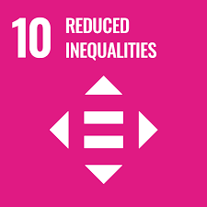
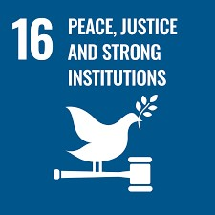
SUSTAINABLE DEVELOPMENT GOALS
TO ENSURE EQUAL OPPORTUNITY AND REDUCE INEQUALITIES OF OUTCOME, INCLUDING BY ELIMINATING DISCRIMINATORY LAWS, POLICIES, AND PRACTICES AND PROMOTING APPROPRIATE LEGISLATION, POLICIES, AND ACTION IN THIS REGARD
CALLS FOR PEACEFUL AND INCLUSIVE SOCIETIES BASED ON RESPECT FOR HUMAN RIGHTS, PROTECTION OF THE MOST VULNERABLE, THE RULE OF LAW, AND GOOD GOVERNANCE AT ALL LEVELS. THE OBJECTIVE OF THIS ANALYSIS IS TO OBSERVE THE RATES OF CRIMES IN THE PHILIPPINES, ESPECIALLY THOSE INVOLVING ILLEGAL DRUGS.
Notes:
this analysis focuses on the SDG 10, which is to ensure equal opportunity and reduce inequalities of outcome, including by eliminating discriminatory laws, policies, and practices and promoting appropriate legislation, policies, and action in this regard, as well as the SDG 16, which calls for peaceful and inclusive societies based on respect for human rights, protection of the most vulnerable, the rule of law, and good governance at all levels.The objective of this analysis is to observe the rates of crimes in the Philippines, especially those involving illegal drugs.
By reevaluating our drug policies through the lenses of SDG 10 and SDG 16, we have an opportunity to create more inclusive societies and peaceful communities. Through a shift towards harm reduction, social inclusion, and evidence-based approaches, we can mitigate the negative consequences of the war on drugs and work towards a more just and equitable world. Let us collaborate to enact progressive drug policies that prioritize public health, human rights, and the well-being of all individuals and communities.

Slide 5
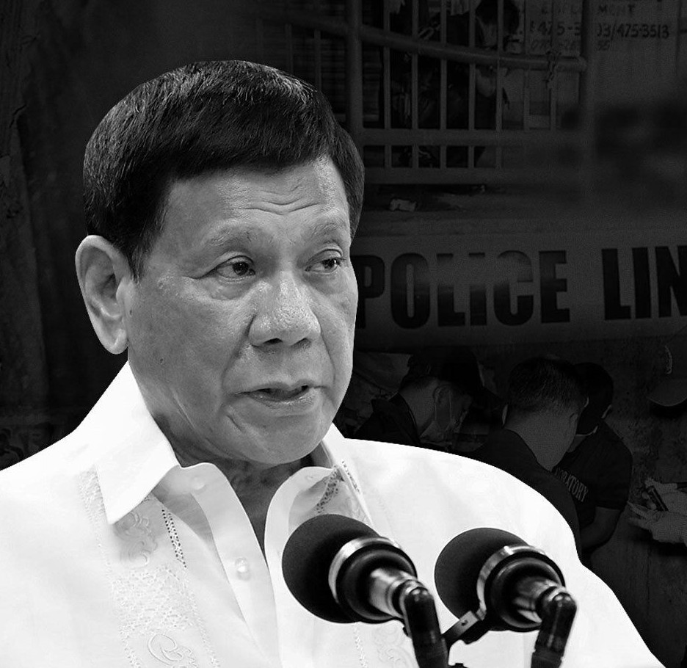
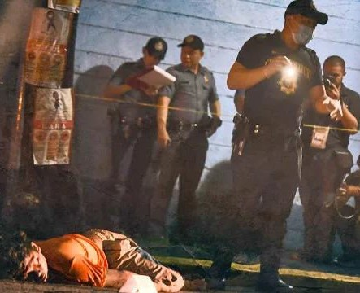
PROBLEM
Hitler massacred three million Jews. Now, there are three million drug addicts. I’d be happy to slaughter them. If Germany had Hitler, the Philippines would have (me). ― Rodrigo Duterte, September 30, 2016
Since the inauguration of President Rodrigo Duterte on June 30, 2016, and his call for a “war on drugs,” Philippine National Police officers and unidentified “vigilantes” have killed over 7,000 people. The anti-drug campaign dubbed “Operation Double Barrel” has targeted suspected drug dealers and users ostensibly for arrest but in practice has been a campaign of extrajudicial execution in impoverished areas of Manila and other urban areas. Duterte’s outspoken endorsement of the campaign implicates him and other senior officials in possible incitement to violence, instigation of murder, and in command responsibility for crimes against humanity.

Slide 6
SIGNIFICANCE OF THE STUDY
THE STUDENTS
THE TEACHERS
THE GOVERENTMENT OFFICIALS
THE FUTURE RESEARCHERS

Slide 7
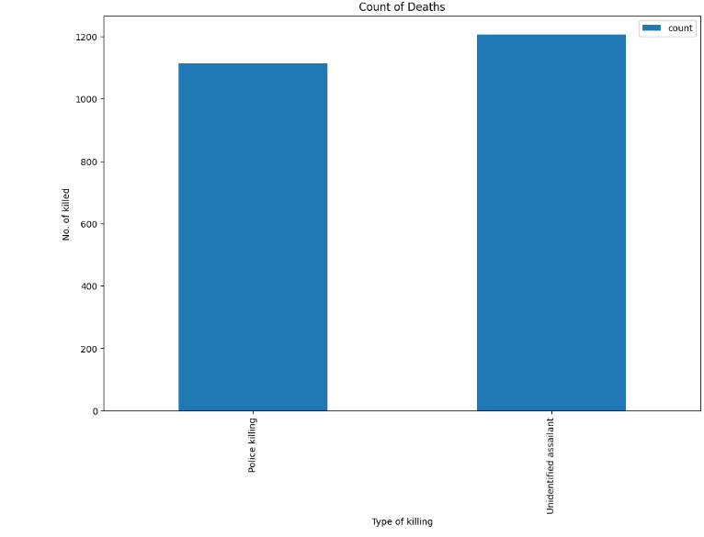
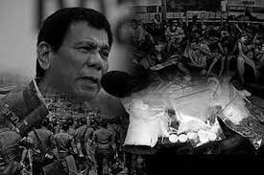
ANALYSIS 1

Slide 8
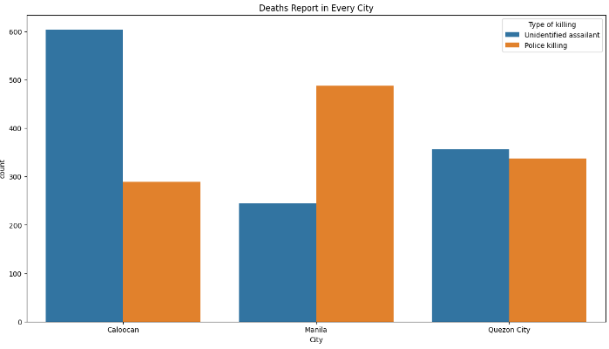
ANALYSIS 2

Slide 9
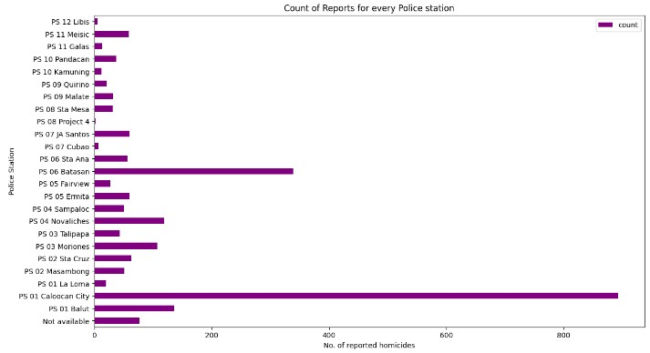
ANALYSIS 3

Slide 10
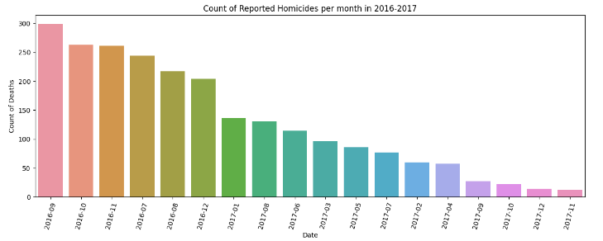
ANALYSIS 4

Slide 11
A
N
A
L
Y
S
I
S
5

Slide 12
RECOMMENDATIONS
Develop a Recommendation system based on the dataset
Raise awareness about drug casualties through online platforms
Stakeholders
Human Rights Organizations
Government
General Public

